Slide 1
Anatomy of a Circuit Board
Row Home Electronics

Slide 2
Disclaimer: I am not an expert.
Notes:
Hobbyist, took one class to get me started. Have done a lot of research on my own. Work as a stage technician etc.
Assume no liability for your actions beyond this class.

Slide 3
Notes:
Lets jump right in

Slide 4
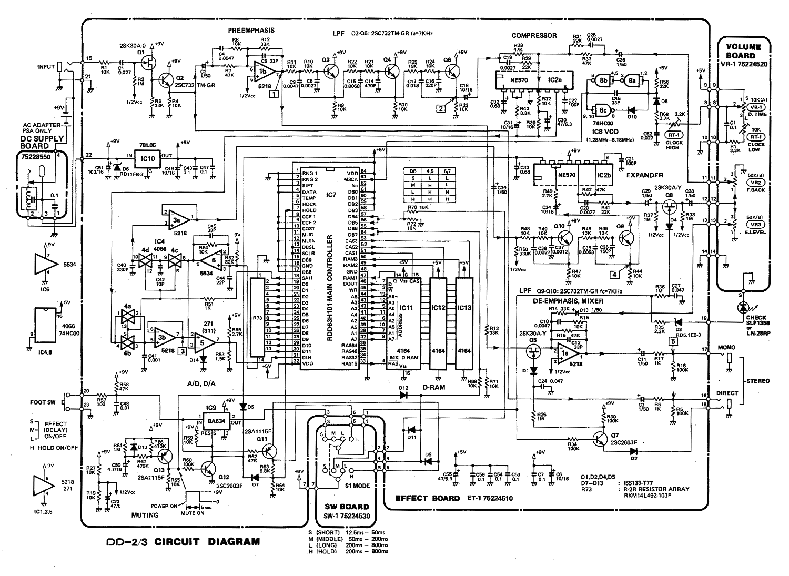
Notes:
Looks easy right?
What do you see
Schematic
Boss Digital Delay Pedal
Follow signal flow

Slide 5
What we’re going to cover:

Slide 6
What we’re going to cover:
Basic Principles
Component Identification
Power Supplies + Safety
Troubleshooting
Signal Flow (maybe)

Slide 7
Notes:
Show story bots electircity clip
14:00
What is electricity,
They’re inside a wire, attached to a generator, magnet spins, induces electrical current in the coil.

Slide 8
Basic Principles
Conductors | Insulators | Semi-Conductors
Notes:
Three catagories of materials
Gold is best
Copper is cheaper
Wood Plastic Rubber
Silicon, gave rise to solid state tech,
Diodes, transistors, etc.

Slide 9
Basic Principles
Current (I) [amp] Voltage (V) [volt] Resistance (Ω) [ohm]
Notes:
Volt is the potential to move electrons
Amp (current) is the flow of electrons
Ohm (resistance) is “reluctance” to the flow of electrons

Slide 10
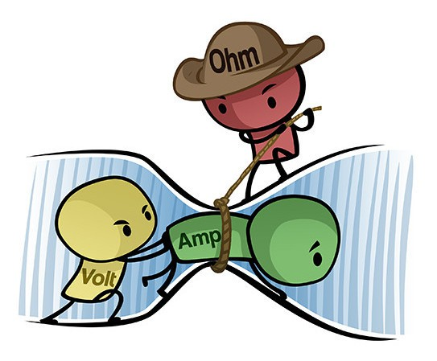
Basic Principles
Current (I) [amp] Voltage (V) [volt] Resistance (Ω) [ohm]
Notes:
Volt is the potential to move electrons
Amp (current) is the flow of electrons
Ohm (resistance) is “reluctance” to the flow of electrons

Slide 11
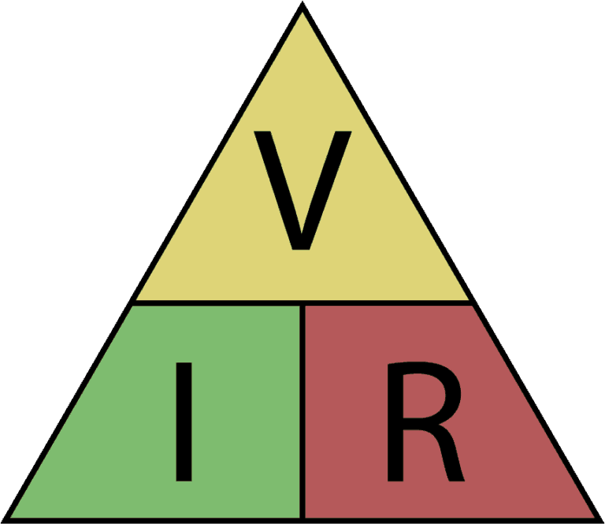
Basic Principles
Current (I) [amp] Voltage (V) [volt] Resistance (Ω) [ohm]
Notes:
Ohms Law
V=IR
I=V/R
R=V/I

Slide 12
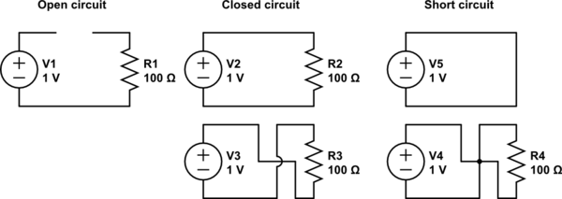
Basic Principles
Circuits
Notes:
Current flows from positive to negative.
Voltage can be present without current (Short circuit)
(no voltage differential)
A load is required in order for current to flow
Current takes the path of least resistance.

Slide 13
Basic Principles
Impedance (𝒵) (Ω) [ohm] Inductance (H) [Henry] Capacitance (F) [farad]
Notes:
“To Impede” complex number, combination of effective resistance and reactance.
Important when connecting equipment together, IE. Speakers to amplifier.
Intentionally mismatch Z to limit current flow for safety, in some instances.
Ability to absorb energy and turn it into magnetism.
Ability to store energy (potential)

Slide 14
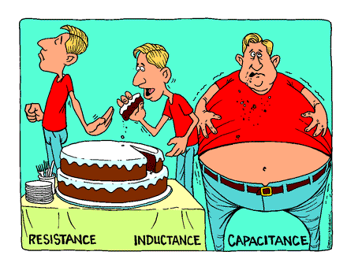
Basic Principles
Impedance (𝒵) (Ω) [ohm] Inductance (H) [Henry] Capacitance (F) [farad]
Notes:
“To Impede” complex number, combination of effective resistance and reactance.
Important when connecting equipment together, IE. Speakers to amplifier.
Ability to absorb energy and turn it into magnetism.
Ability to store energy (potential)

Slide 15
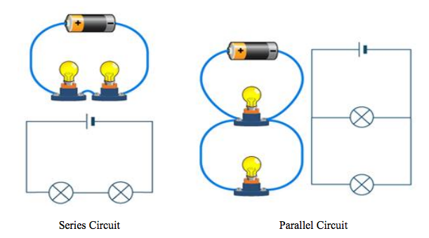
Basic Principles
Series vs Parallel
Notes:
As current is pushed through the circuit, each component’s resistance “uses up” some of the available voltage.
This is called voltage drop.
Lamps in series will be half as bright.
Parallel allows for current to pass through both lamps simultaneously.
Residential AC outlets are wired in parallel.

Slide 16
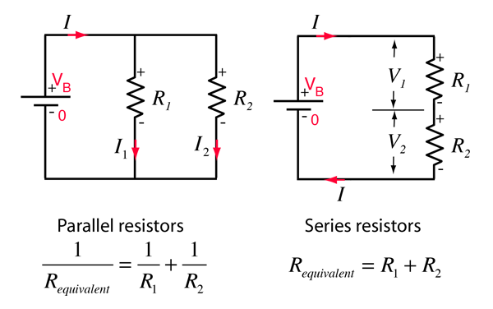
Basic Principles
Series vs Parallel
Notes:
Parallel:
Each component sees the same voltage.
Current is divided between all paths
Series:
Each components sees a portion of the voltage
But current is the same

Slide 17
Power
Notes:
A word about safety

Slide 18
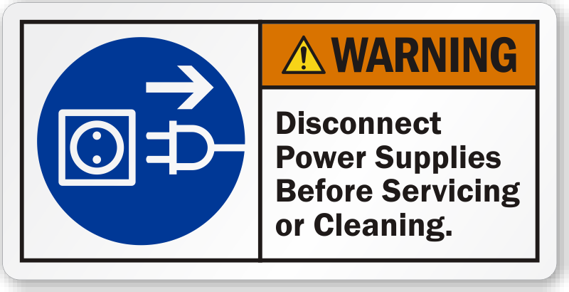
Safety
Always unplug electrical equipment before servicing!
Notes:
I did this once. It was stupid. Dont do it. I fried the equipment I was working on, and could have been seriously injured.
Used to working on low voltage DC battery op. equipment, which is okay to work on while powered.

Slide 19
Safety
Household voltage is 120v AC
Circuits are usually 15-20 amps
It only takes 100mA to stop your heart
Have a healthy respect
Notes:
Current has to pass through your heart to stop it.
Use only one hand, etc.
thats only .1A
Theres some exceptions, to working on things while powered.
Low power, battery operated DC voltage.

Slide 20
Power
Notes:
Two basic types

Slide 21
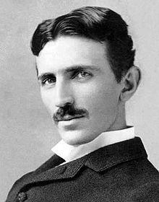
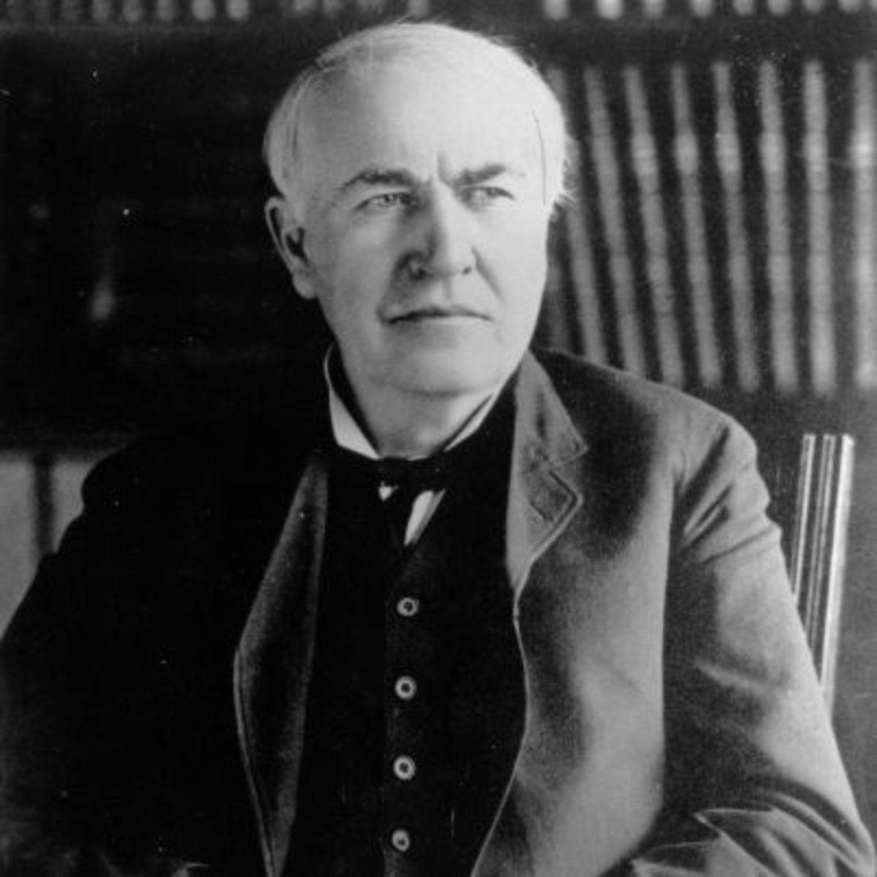
Power
AC VS DC
Notes:
Topsy the elephant
Household is AC, transmission is AC
Transformed into DC, Wall warts
Low voltage

Slide 22
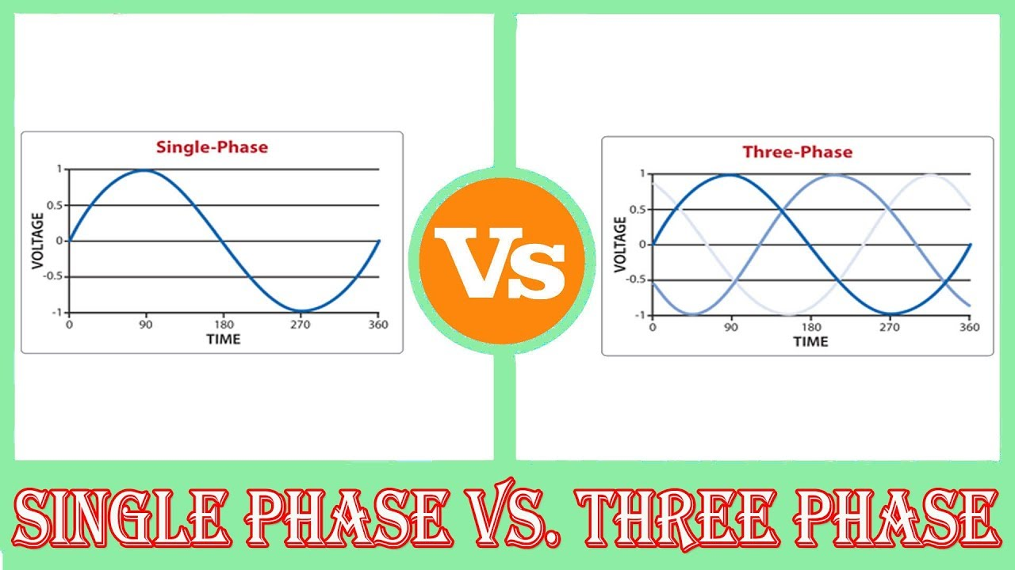
Alternating Current
Notes:
Household is 120v single phase at 60Hz.
Three phase is generally at least 220v, more commercial use.
There is a moment of 0V 60 times a second.
Not the case with 3 phase.

Slide 23
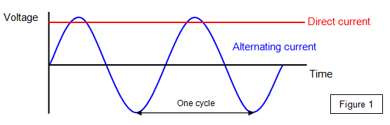
Direct Current
Notes:
See the AC wave.
Same voltage in AC & DC.

Slide 24
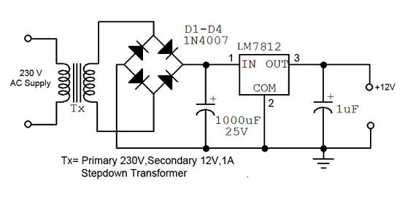
Power
Inside a “Wall Wart” Supply
Notes:
This schematic takes 230V AC, uses a transformer to convert to 12V AC
This also isolates the rest of the circuit from the AC mains.
The diode bridge converts the 12V AC to 12v DC.
The LM7812 is a regulator, here converting 12vDC to 12vDC.
Acts a buffer, in junction with the large capacitors to provide smooth power output.
Notice the polarity.
230v over 120v ohms law

Slide 25
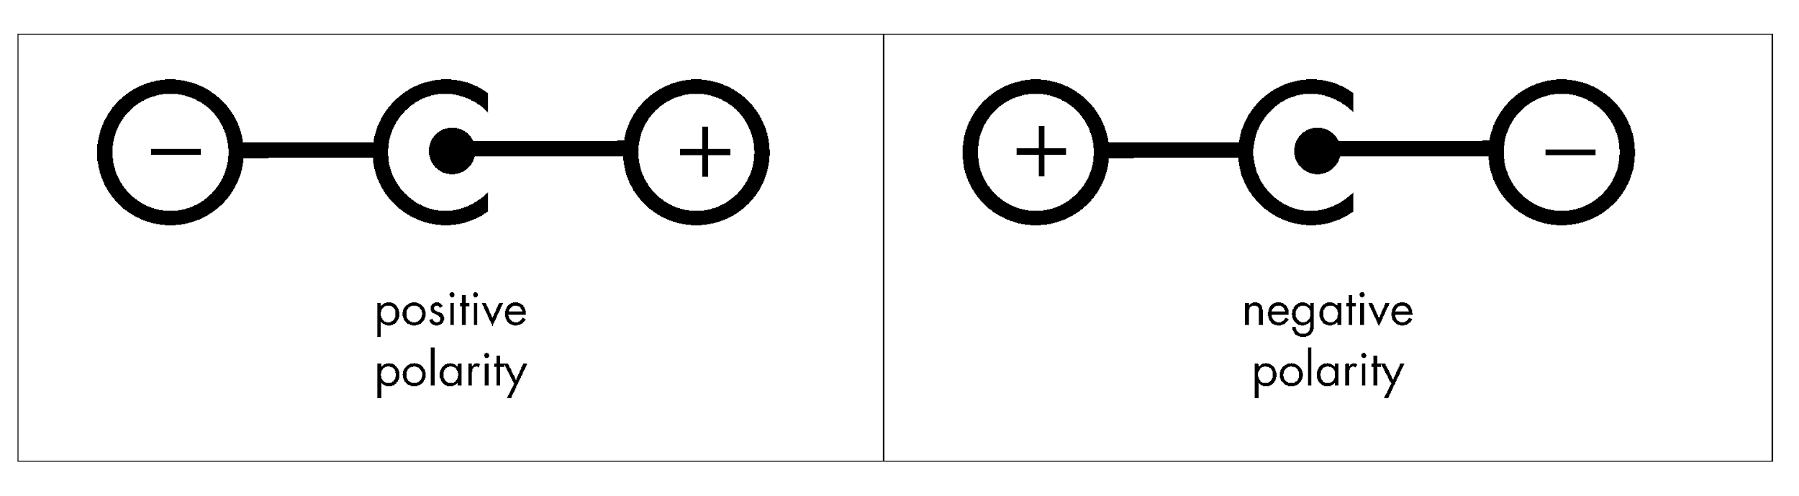
Power
Power Supply Unit (PSU) Polarity
Notes:
Always take note of polarity when matching a power supply to a piece of equipment.
Center Positive
Center Negative

Slide 26
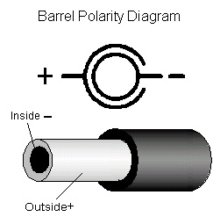
Power
Supply Polarity
Notes:
Always take note of polarity when matching a power supply to a piece of equipment.
Center Positive
Center Negative

Slide 27
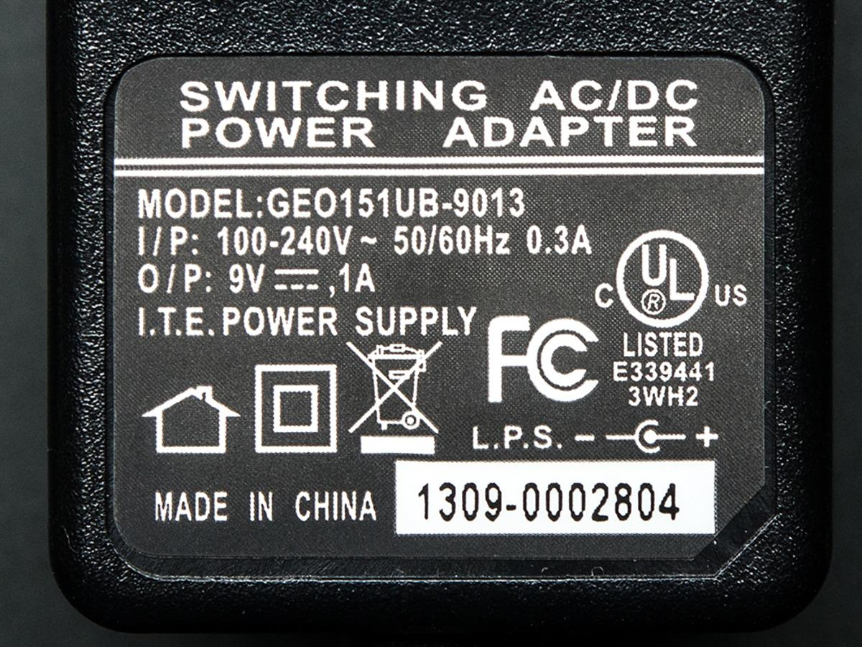
Power
Power Supply Unit
Notes:
You need to match the Voltage
As long as it can deliver more current than the equipment is asking for
Its all good
Always observe polarity.

Slide 28
Power
Notes:
What do yall see? Picture of equipment. Or hands on demo.

Slide 29
Power: Conclusions
Notes:
Got through that whole thing without doing this

Slide 30
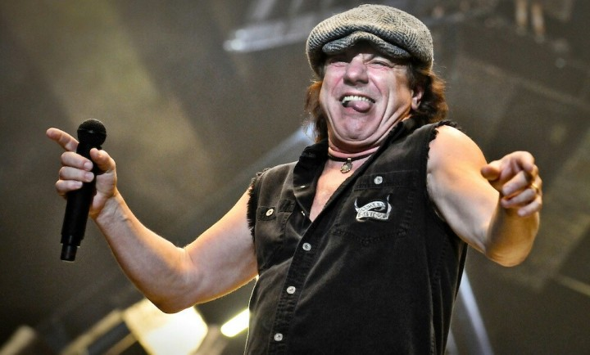
Notes:
Brian Johnson

Slide 31
The Printed Circuit Board
Notes:
PCB
Older boards are generally brown, with a dedicated component side, and printed side.
Newer boards can be variety of colors and usually consist of multiple layers of printed conductive material.

Slide 32
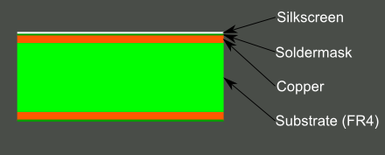
PCB
Notes:
Older style board. Usually only etched on one side.

Slide 33
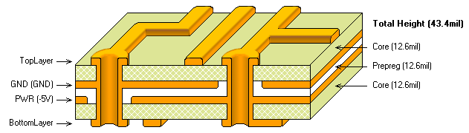
PCB
Notes:
A 4 layers PCB
Note the ground & VCC plane.
Plated through hole.
Can have up

Slide 34
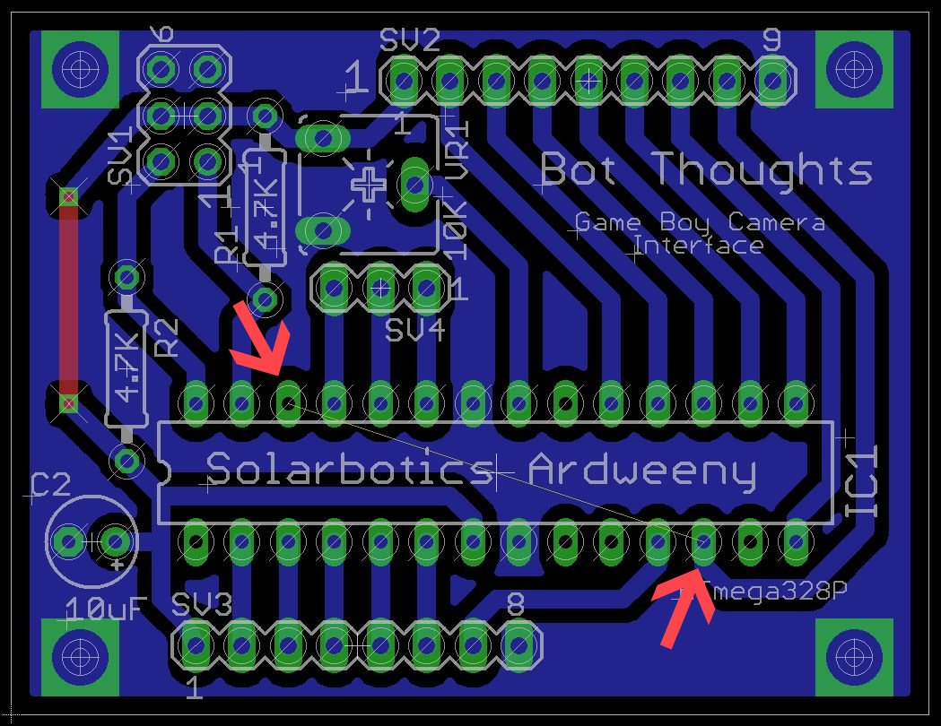
PCB

Slide 35
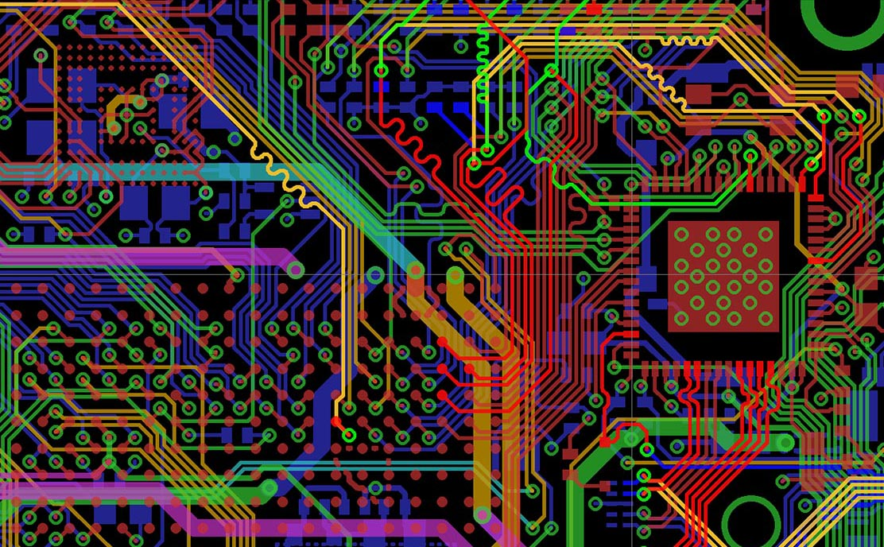
PCB

Slide 36
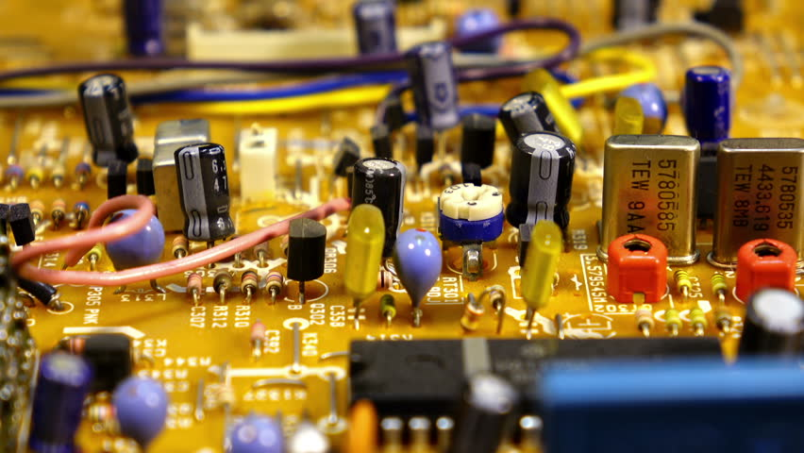
PCB

Slide 37
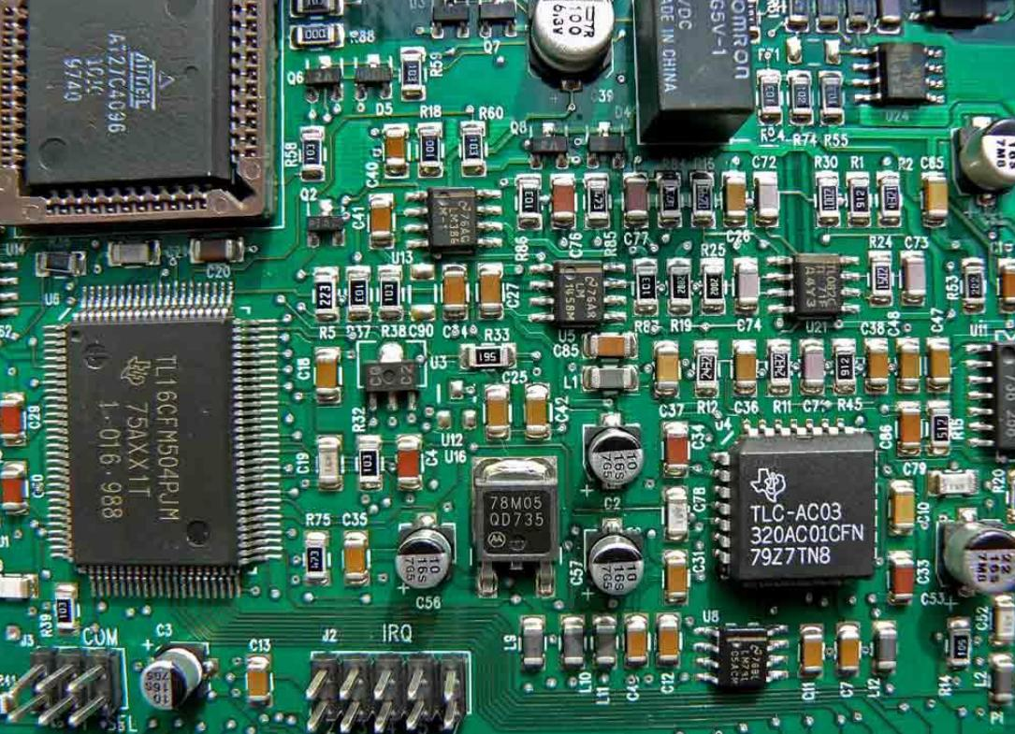
PCB

Slide 38
Component Identification

Slide 39
Component Identification
Passives & Actives

Slide 40
Passives
Consume electricity but can not produce it
Resistors | Capacitors | Inductors
Notes:
Resist current, can be used to route current and voltage through logic gates
Capacitors store voltage/current, act as electronic filters
Inductors covert electricity to magnetism and back.

Slide 41
Actives
Powered components that can amplify signal
Vacuum Tubes | Solid-State
Notes:
To say, Increase power, voltage or current.
Solid state, semi conductors
Transistor
Integrated Circuit
Silicon

Slide 42
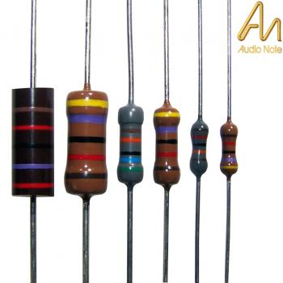
Resistors
Notes:
Carbon Film
Wattage rating, bigger = more power before burning up

Slide 43
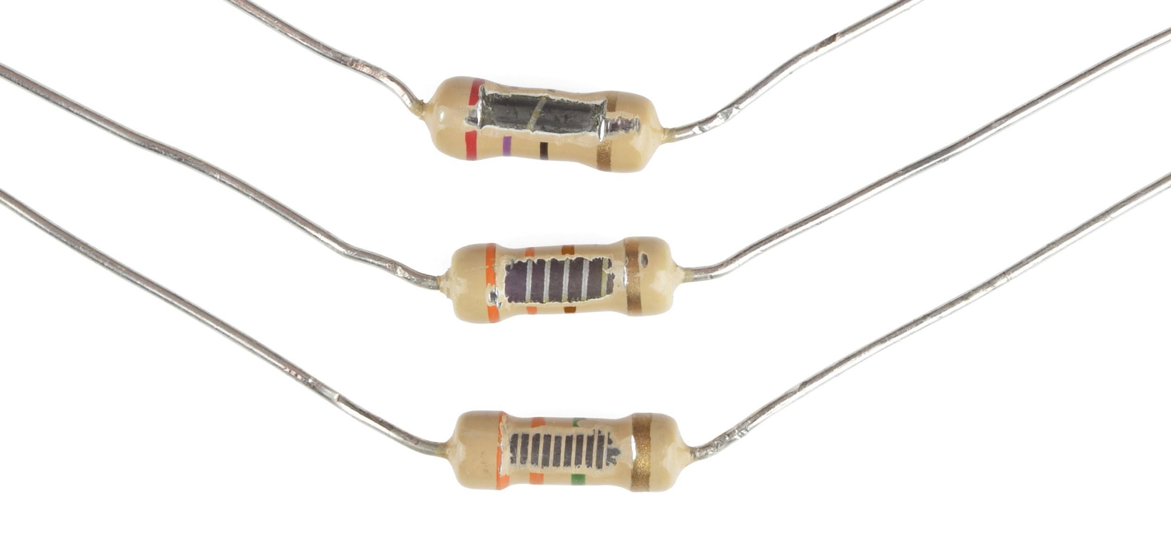
Resistors
Notes:
Note, more turns = higher resistance

Slide 44
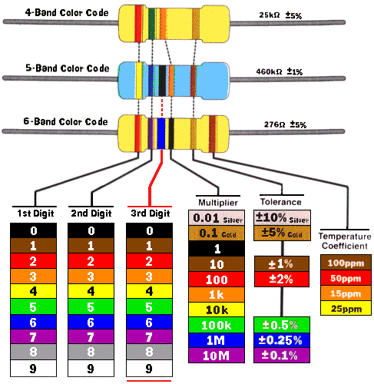
Resistors
Notes:
Color code
Tolerance, always test with Multimeter before installing
Or performing calculations

Slide 45
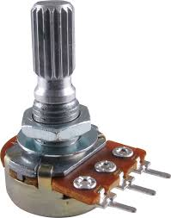
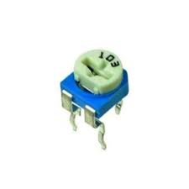
Resistors
Potentiometer
Trimmer
Notes:
Variable resistors

Slide 46
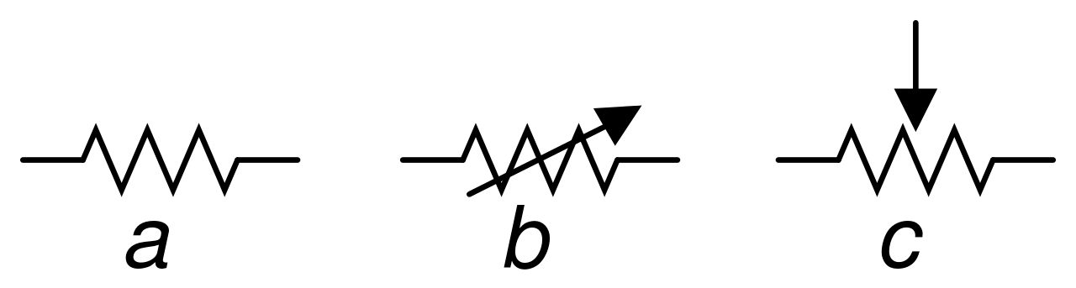
Resistors
Notes:
A resistor
B Trimmer
C Potentiometer

Slide 47
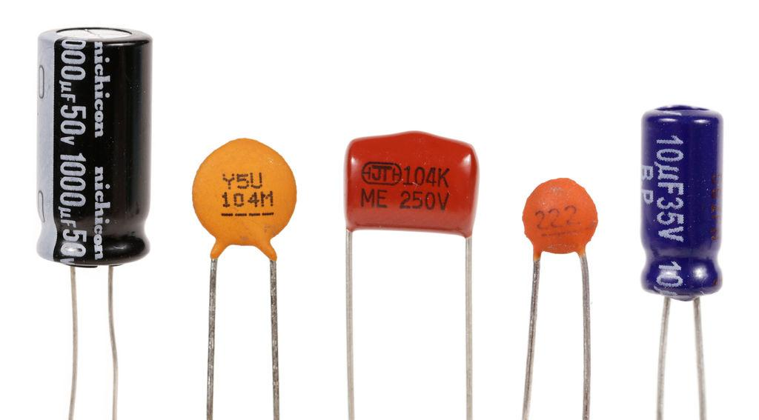
Capacitors
Notes:
Ceramic disk are most common and inexpensive
Varying degrees of charge/drain time

Slide 48
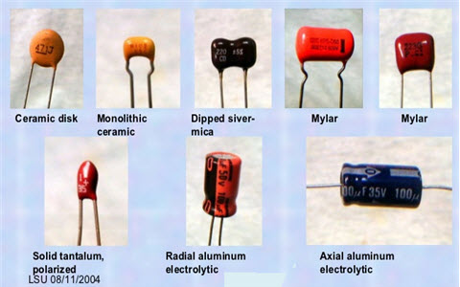
Capacitors
Notes:
Ceramic disk are most common and inexpensive
Varying degrees of charge/drain time

Slide 49
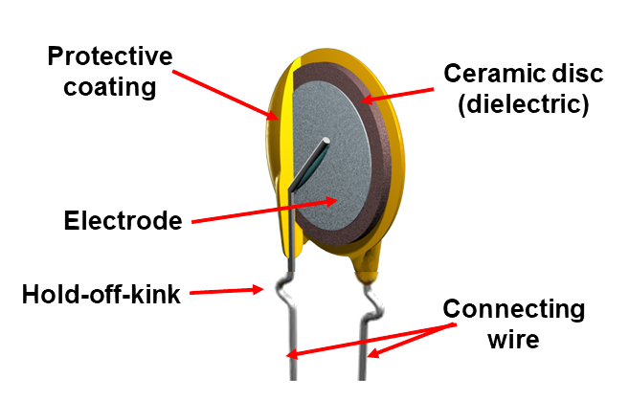
Capacitors
Notes:
Ceramic disk are most common and inexpensive
Dieletrics material (electrode) This is what holds the charge.

Slide 50
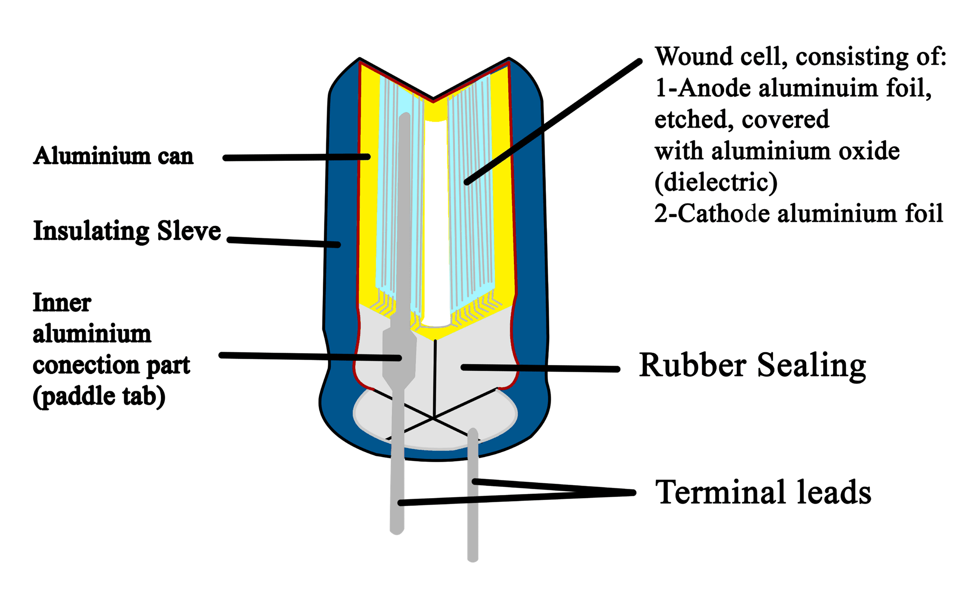
Capacitors
Notes:
Polar

Slide 51
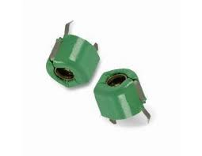
Capacitors
Notes:
Variable capacitor, trimmer style

Slide 52
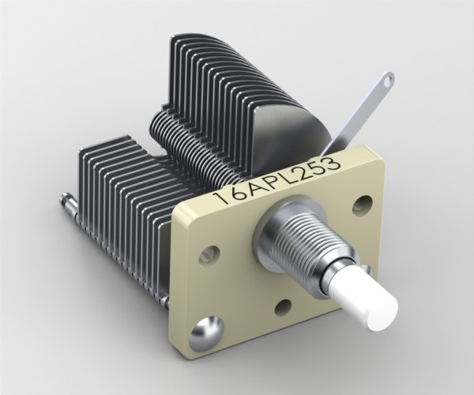
Capacitors
Notes:
Air-Dielectric variable capacitor
Mostly used for HAM radio
Not seen often.
Charges the air between the plates.

Slide 53
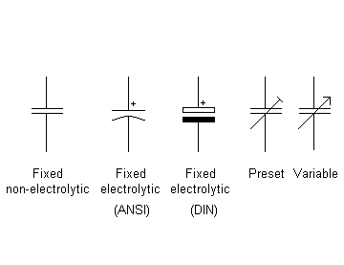
Capacitors
Notes:
Ansi & Din are different standards. They vary.
Preset is trimmer.

Slide 54
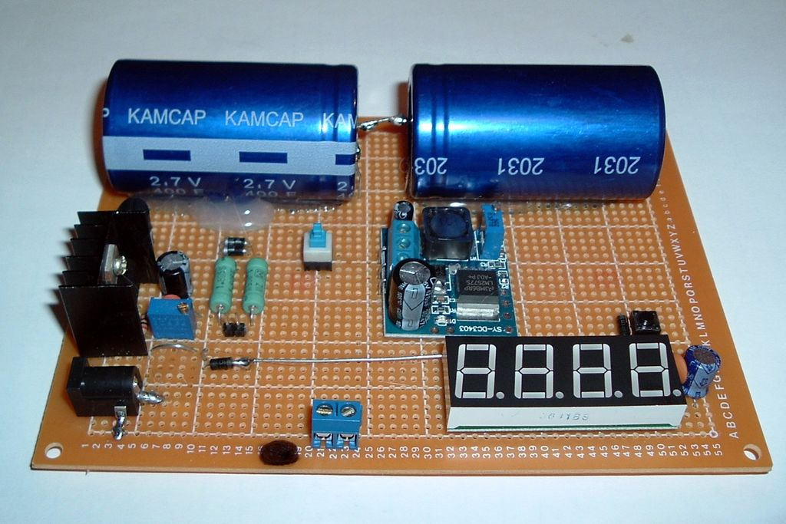
Capacitors
Notes:
Capacitors can be very large, can hold alot of charge.
These take time to drain after power is turned off. (which is why we use them, a large cap can smooth out unstable power supplies.)
This is why sometimes when you turn off a device, the lights stay on for a few seconds. Its the caps draining to ground.
Be cautious when working around large caps. (even on battery operated devices)

Slide 55
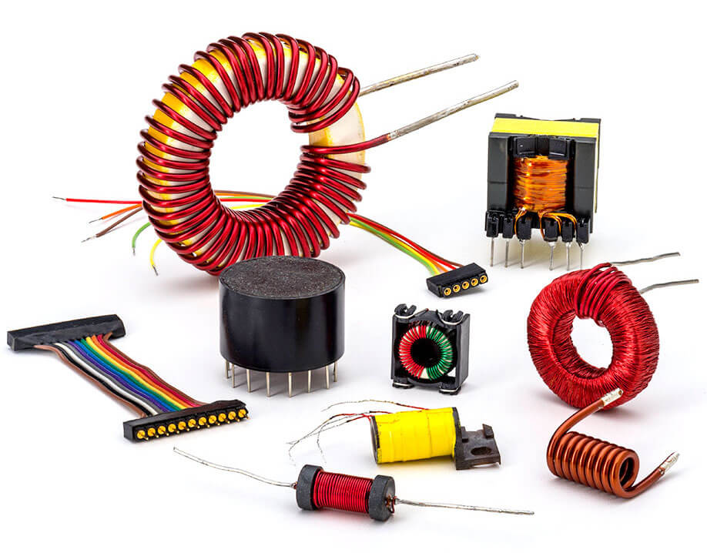
Inductors
Notes:
A note, Inductors and Capacitors make up Reactance.
This combined with resistance, makes up impedance.
Inductors are coils.
Iron core
Ferrite core
Air core

Slide 56
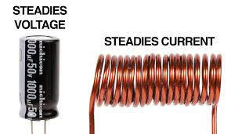
Inductors
Notes:
Inductor is basically a coiled up conductor.
Utilizes induction, can transfer energy through a created magnetic field
Motors work on this principle, you energize a coil, and a magnet spins inside.
The rotor and the stator.
Generators use a gas or diesel motor to spin a magnet (rotor) and create a charge in an coil (stator)
In circuits they can be used to smooth current fluxuations

Slide 57
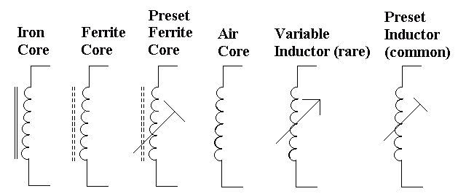
Inductors

Slide 58
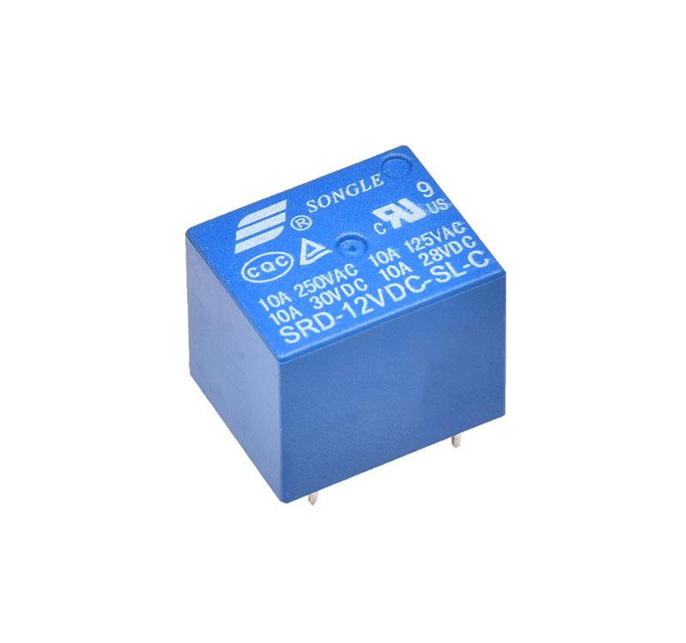
Inductors
Notes:
Another component that relies on inductance and coils is the relay.
Electrically activated mechanical switch

Slide 59
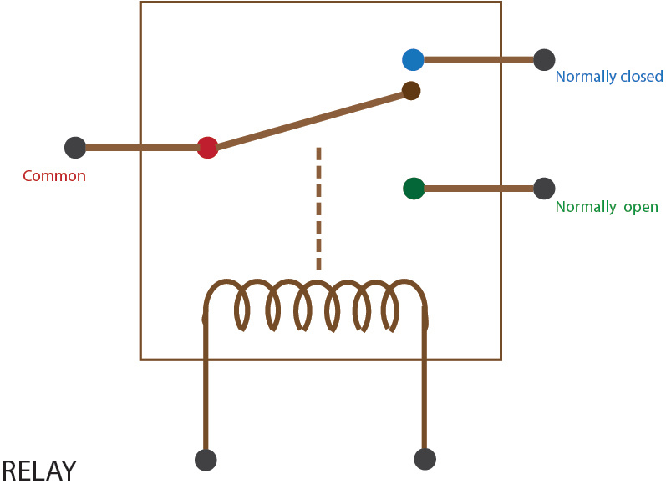
Inductors
Notes:
Coil and switch are isolated from one another.
Can be used to switch things on or off.

Slide 60
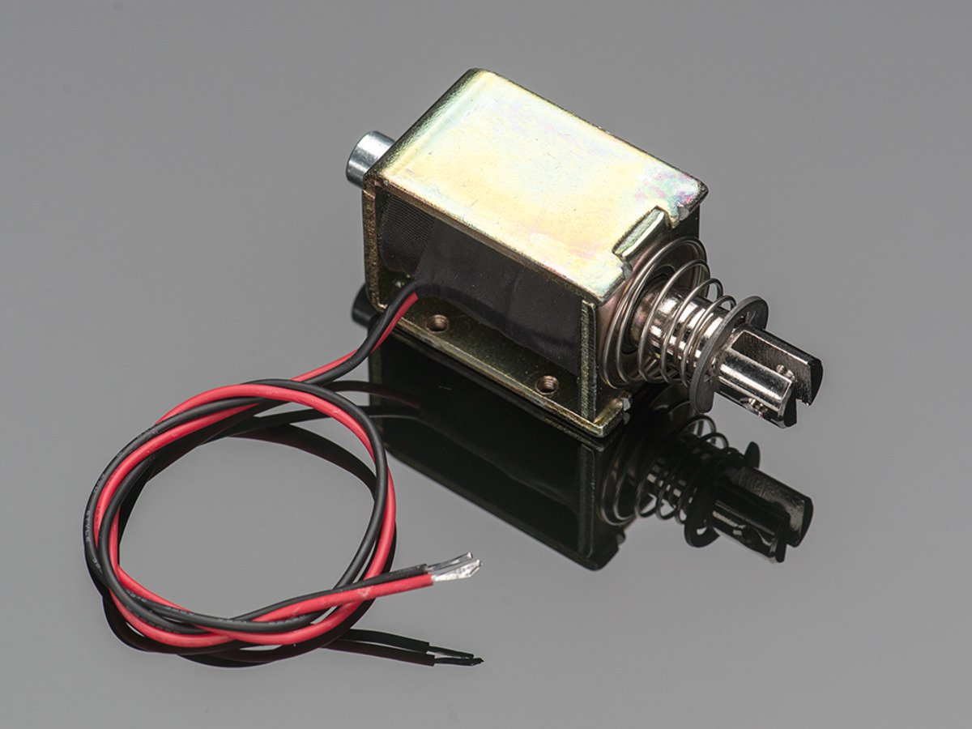
Inductors
Notes:
Solenoid
Coil, magentism, push or pull
used in things like locking doors or opening cash registers

Slide 61
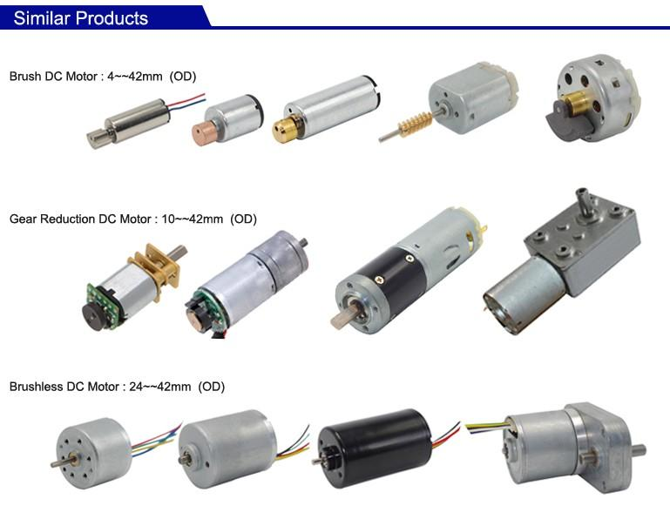
Inductors
Notes:
DC motors
when you energize the coils, it causes magnets to spin
gear reduction, speed decreases but torque increases.

Slide 62
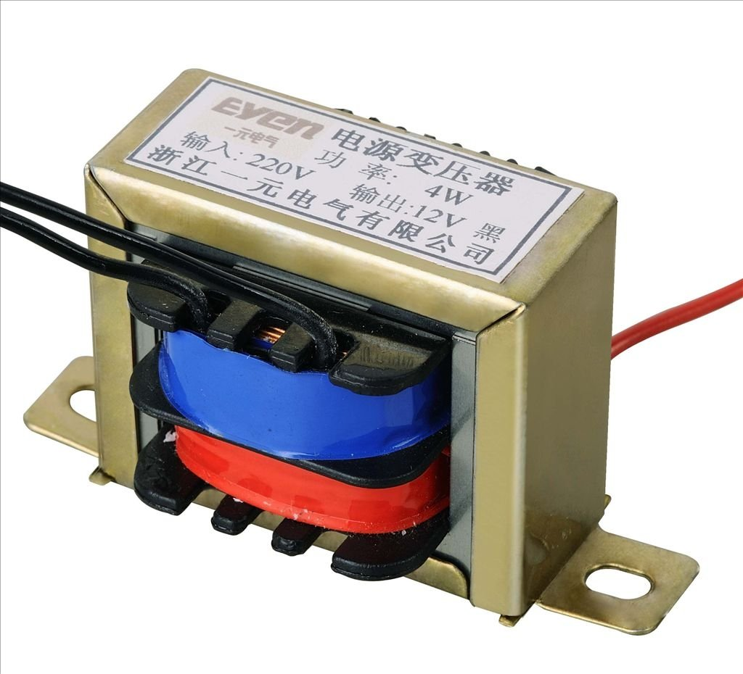
Inductors
Notes:
Most common use I see, is in a transformer
Transforms ac voltage usings two coils that do not touch.
Depending on number of turns of the coils, determines what the output voltage is.
Isolates equipment from mains

Slide 63
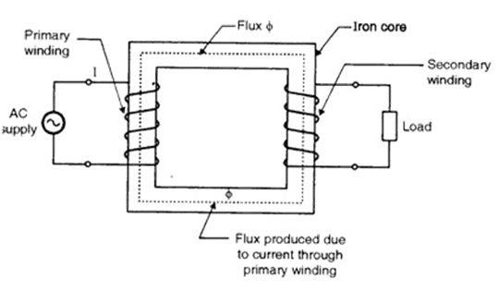
Inductors
Notes:
Most common use I see, is in a transformer
Transforms ac voltage usings two coils that do not touch.
Depending on number of coils, determines what the output voltage is.
Isolates equipment from mains

Slide 64
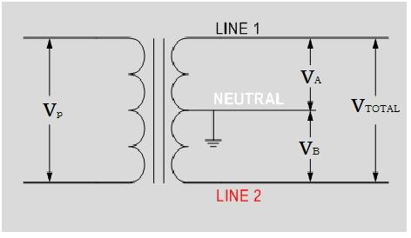
Inductors
Notes:
Center tap gives half Voltage
Used in a residential application, one can have 240v for washer dryer service
And use the center tap for 120v
As an example.

Slide 65
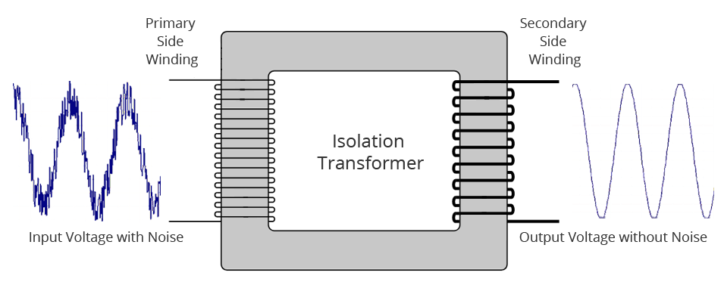
Inductors
Notes:
Besides smoothing outputs, there is another reason for isolation transformers

Slide 66
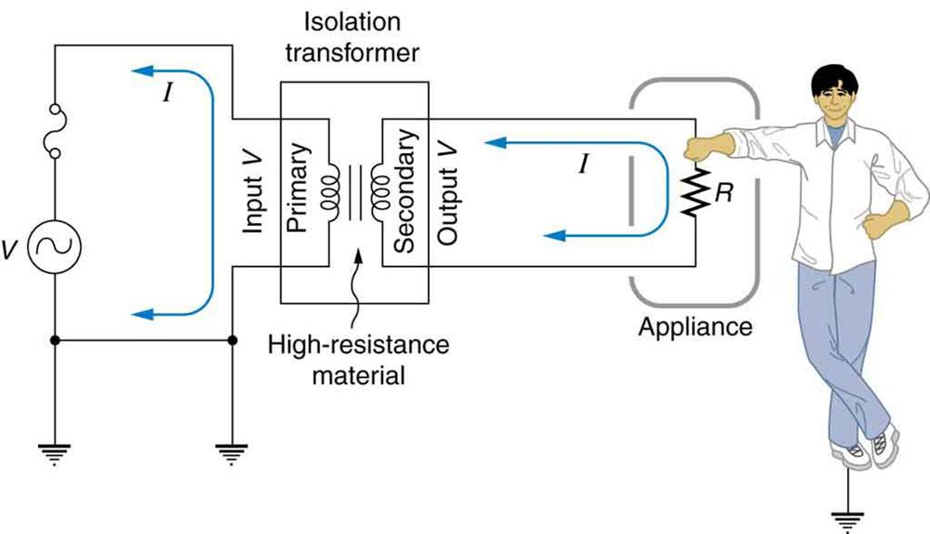
Inductors

Slide 67
Inductors
Notes:
If the secondary output would be earth grounded, and you entered the circuit, you would create a dangerous path to ground.

Slide 68
Inductors
Notes:
Might be confusing
The ground symbols are the earth. That’s where “ground” comes from.
If the secondary windings are not “floating” then when you come in contact
You form a circuit, and the electricity flows through you.

Slide 69
Inductors
Notes:
And if that goes through your heart..
Ideally this goes through your right arm, then down your leg, you could survive.
But if both hands touch high current, electricity goes right across your chest.

Slide 70
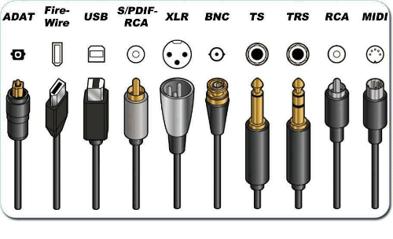
Connectors

Slide 71

Switches
Notes:
Makes an electrical connection, physically.
Many different kinds. Basically all do the same thing.
Connect to electrical leads together.
Momentary
Latching
Pole/Throw

Slide 72
Actives
Powered components that can amplify signal
Vacuum Tubes | Solid-State
Notes:
To say, Increase power, voltage or current.
Solid state, semi conductors
Transistor
Integrated Circuit
Silicon

Slide 73

Vacuum Tubes
Notes:
The type of tube used in early computers was called a triode and was invented by Lee De Forest in 1906. It consists of a cathode and a plate, separated by a control grid, suspended in a glass vacuum tube. The cathode is heated by a red-hot electric filament, which causes it to emit electrons that are attracted to the plate. The control grid in the middle can control this flow of electrons. By making it negative, you cause the electrons to be repelled back to the cathode; by making it positive, you cause them to be attracted toward the plate. Thus, by controlling the grid current, you can control the on/off output of the plate.

Slide 74

Vacuum Tubes
Notes:
I dont really know honestly.

Slide 75

Vacuum Tubes
Notes:
Nixie tubes

Slide 76

Vacuum Tubes
Notes:
A bunch of on off signals, and current running through different elements to light up different bits.

Slide 77

Vacuum Tubes
Notes:
Might be great for tone, but Thing to take away was that they are unreliable as a switch.

Slide 78
Solid-State
Semi-Conductors
Revolutionized the industry

Slide 79

Transistors
Notes:
Now you have electronic switches, with no moving parts.
Electronic logic.
Invented 1947
Smaller, consumes less power.
Less prone to failure.
Gave rise to the modern computer.

Slide 80

Transistors
Notes:
Now you have electronic switches, with no moving parts.
Electronic logic.
Invented 1947
Smaller, consumes less power.
Less prone to failure.
Gave rise to the modern computer.

Slide 81
Transistors
Notes:
Into collector
Out of emitter
Base is control

Slide 82

Transistors
Notes:
Into collector
Out of emitter
Base is control

Slide 83

Transistors
Notes:
Adding a resistor at the collector limits the gain of the amplifier.

Slide 84

Diodes

Slide 85

Diodes

Slide 86
Diodes
Notes:
Generic
LED

Slide 87

Integrated Circuits (IC)
Notes:
Mostly complete circuits in a discrete package.
Vast array of functions. Logic gates, Op amps, Microprocessors, Timers, RAM
Datasheets are imperative to determining function.

Slide 88

Integrated Circuits (IC)
Notes:
Mostly complete circuits in a discrete package.

Slide 89

Integrated Circuits (IC)
Notes:
Op amp symbol. Some chips have 1 or up to 4 in a single package. These are used for things like amplifiers, feedback stuctures, buffers.

Slide 90

Integrated Circuits (IC)
Notes:
Op amp symbol. Some chips have 1 or up to 4 in a single package. These are used for things like amplifiers, feedback stuctures, buffers.

Slide 91

Integrated Circuits (IC)
Notes:
Most common IC, 555 timer. Can be configured multiple ways based upon external components.

Slide 92

Integrated Circuits (IC)
Notes:
Most common IC, 555 timer. Can be configured multiple ways based upon external components.

Slide 93

Integrated Circuits (IC)
Notes:
Atmega328 microcontroller
Brain of an Arduino. Must have firmware installed to it.
Runs code.

Slide 94
Q&A

